Slide 1
Brexit Challenges to the Regulatory Regime Governing Food and Drugs
Maree Gallagher
Of Counsel

Slide 2
AgriFood Trade
Ireland exports 90% production
Food & Drink exports 2017 = €13.6 billion
173,000 Employed
38% of Exports UK
50% Beef / 22% Dairy

Slide 3
Overview
State of Play
Where are we now?.
Possible Outcomes
HARD BREXIT /SOFT BREXIT
Drug Regulatory Considerations
Food Regulatory Considerations
UK No Deal Notices
Key Issues
Key Issues
GIs, Food Labelling, Food containing products of animal origin, Tariffs and Customs
Tariff Example; EU no deal contingencies; key concerns for Irish law
Finally…..

Slide 4
State of Play
Up until December 2017
phase one on budget, citizens and Ireland only.
29 January 2018
the Council adopted negotiation directives for an agreement with the UK “setting out the arrangements for its withdrawal from the EU”
29 June 2018
28 February 2018
2 March 2018
23 March 2018
the Commission published the draft Withdrawal Agreement.
Theresa May’s Lancaster House speech: first signs of sector-by-sector cherry picking.
“…the European Council has to take into account the repeatedly stated positions of the UK, which limit the depth of such a future partnership. Being outside the Customs Union and the Single Market will inevitably lead to frictions.”
EU Council, withdrawal agreement was supposed to be agreed.
6 July 2018
Chequers meeting, publication of UK white paper on future relationship with EU.
23 August 2018
UK publishes 1st batch of no deal documents.

Slide 5
State of Play – The Latest
After Wednesday 17 October 2018 European Council:
The negotiations are “completely deadlocked”.
Suggestion of extension came from UK initially, but was floored by Commission in order to help her.
Doesn’t solve the back-stop problem.
No European Council scheduled for November anymore.
Until N Ireland (“backstop”) is resolved, no discussion on future relationship.
“the ball is entirely in the British camp“
On 14 NOV 2018:
Next 48 hours will be critical
Then - we have a text!
No deal contingencies published by EU
SWIMMING POOL

Slide 6
Possible Outcomes
 |  | “Transition” 30.3.2019 to 31.12.2020 | “Future relationship” 1.1.2021 - …
Soft Brexit | Regulatory | EU law applies as if UK were a member state | EEA-type agreement (extension/duplication of Internal Mkt)
 | Trade | Customs union | No customs union but deep facilitation
Hard Brexit | Regulatory | Limited unilateral recognition on each side | Sector agreements + MRAs
 | Trade | WTO (“Emergency FTA”) | CETA-type FTA
Extension…: article 50 or transition?

Slide 7
Drug Regulatory Considerations
No UK participation in EU regulatory processes or networks
Marketing authorisations
Regulatory infrastructure
Orphan designations
Clinical trials
Inspections & Product Release

Slide 8
Food Regulatory Considerations
Official Controls
Labelling
Safety
Veterinary Controls
GMOs
RASFF

Slide 9
Hard Brexit: UK No Deal Notices
Geographic Indications
All 86 UK GIs protected under EU regime to be automatically given new UK GI status
Scheme will be WTO/TRIPS compliant
If no deal, UK Government will set up its own GI scheme
UK will not have to recognise EU GI status anymore
Unclear whether current UK GIs would still be protected under EU regime
If not, producers will have to apply to European Commission as third country producers

Slide 10
Hard Brexit: UK No Deal Notices
Food Labelling
Labels on UK-manufactured products would no longer fall within scope of “EU” as descriptor of origin
UK food products sold in EU-27 will have to include name and address of responsible FBO which must be located in EU Member State, or else details of the relevant importer
Food sold in UK must bear details of either UK-based FBO or relevant UK importer
Six month transitional period in which companies allowed to sell products labelled with EU FBO

Slide 11
Hard Brexit: UK No Deal Notices
Foods containing products of animal origin
Documentation for UK exports of FPAOs would need to be changed to reflect the fact UK is no longer an EU Member State
Before any exports can take place, EU will need to grant UK listed third country status
UK-produced FPAOs would be inspected and signed off at a Border Inspection Post within the EU, to permit onward travel
UK producers exporting foods containing products of animal origin (“FPAOs”) will need to obtain Export Health Certificate (“EHC”)
UK Government will inform stakeholders of any changes to existing process

Slide 12
Hard Brexit: UK No Deal Notices
Tariffs and customs duties
EU will require payment of customs duty at rate under EU’s Common Customs Tariff & UK will require payment of customs duty at rate to be set by UK Government
More favourable terms could only be reached by agreeing separate free trade agreement with EU
General UK Government guidance for no-deal Brexit says trade with EU would be on WTO terms
Food sector no-deal notices do not directly address tariffs and customs relating to food and beverage producers

Slide 13
Trade in shortbread after Brexit
Ireland
Butter
Germany
Sugar
France
Flour
UK
manufacturing
EU
Shortbread

Slide 14
Hard Brexit: Non preferential import of UK shortbread into EU
Ireland
Butter
Assuming UK adopts EU’s schedule.
Germany
Sugar
France
Flour
HS 040510 – Butter
Non-TRQ, MFN non-AV duty | 189.6 EUR/100kg
HS 170290 – Sugar
MFN applied tariff, AV duty | 12,8 %
Note: 12,8 % under EU-Colombia FTA and 8,9 % under EU-South Africa FTA
UK
manufacturing
HS 110100 – Wheat flour
Non-TRQ, MFN non-AV duty | 172 EUR/ 1000kg
Export to EU: next slide
EU
Shortbread

Slide 15
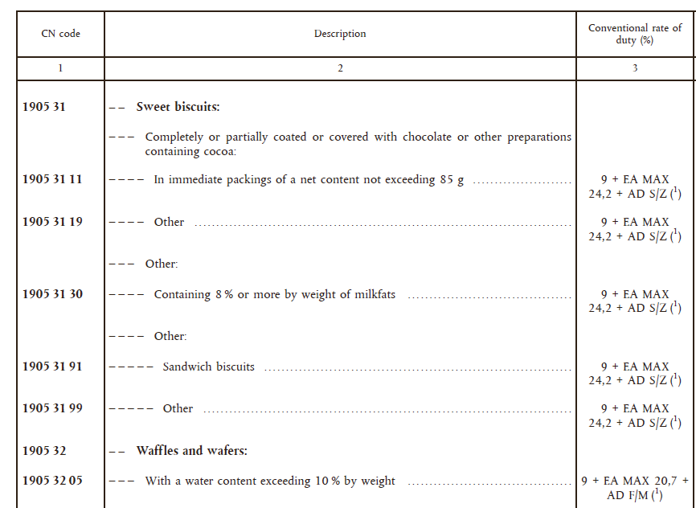
Hard Brexit: Non preferential import of UK shortbread into EU
First, classify shortbread under correct code of the EU’s Common Nomenclature (“CN”)
Explanatory notes:
This subheading includes butter biscuits.

Slide 16
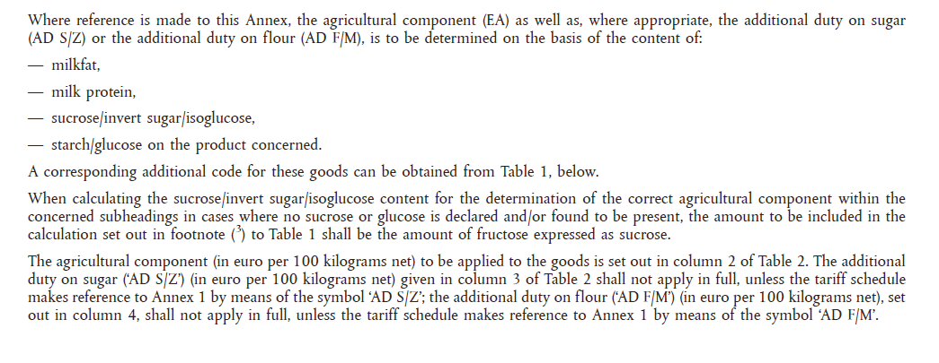
Hard Brexit: Non preferential import of UK shortbread into EU
Second, calculate applicable duty rate:
Conventional duty rate of 9 % plus agricultural component in EUR per 100 kg plus additional duty on sugar.
Bottom line: it’ll cost more to do business?

Slide 17
Stockpiling and Continuity of Supply
Guidance from UK Government envisages stockpiling
Underpinned by a legal obligation to ensure "appropriate and continued supplies" to pharmacies and suppliers (Art 81, Directive 2001/83/EC)
UK implementing regulations required

Slide 18
Hard Brexit: EU Contingencies
EU Approach to No Deal
Published on 13th November 2018
Address key priority areas – i.a air travel, visas, security.
Article 50 Task Force leading

Slide 19
Key Issues for Irish Law
Regulatory Divergence will be the biggest challenge
Precise terms and definitions in any transition
Single market rules regarding SPS issues will continue
Food Fraud & Falsified Medicines

Slide 20
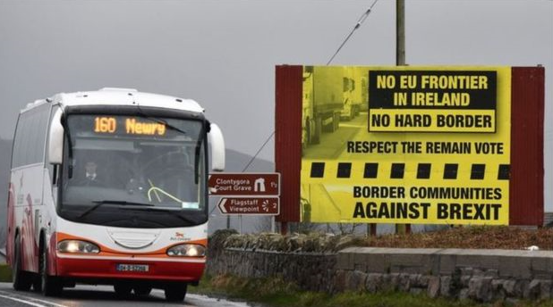
Possible Outcomes
 |  | “Transition” 30.3.2019 to 31.12.2020 | “Future relationship” 1.1.2021 - …
Soft Brexit | Regulatory | EU law applies as if UK were a member state, imperfect | EEA-type agreement (extension/duplication of IM)
 | Trade | Customs union | No customs union but deep facilitation
Hard Brexit | Regulatory
 | Trade
Extension… |  |  | Backstop?
Picture source: Irish times

Slide 21
Questions?

